Slide 1
Climate: Water Consumption Calendar
Team Merritt: Matthew and Michael Merritt

Slide 2
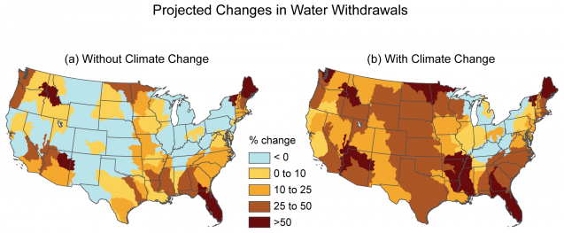
Climate and Water Consumption
Climate change will have a severe impact on water availability in the future if trends continue
Saving water is essential for two reasons:
We need to stop wasting water and preserve some of that water for the future
We need to gradually decrease the amount we require to adapt ourselves to climate change

Slide 3

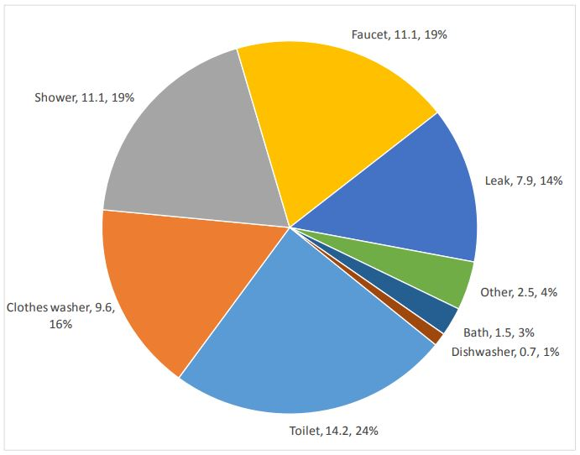
Motivation and Ideas for the Calendar
We wanted to make a daily calendar so the user can keep track of consumption and focus on improvement over time
The averages and comparisons to the average American allow the user to know how they are doing compared to their peers

Slide 4
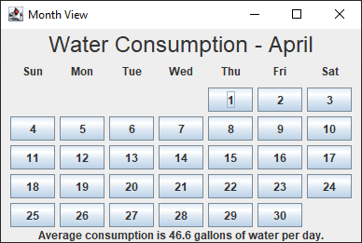
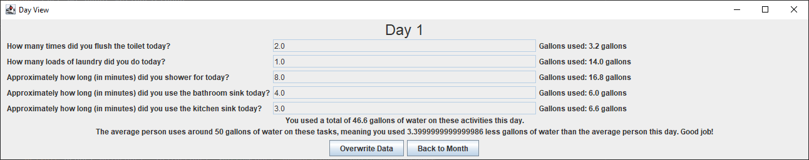
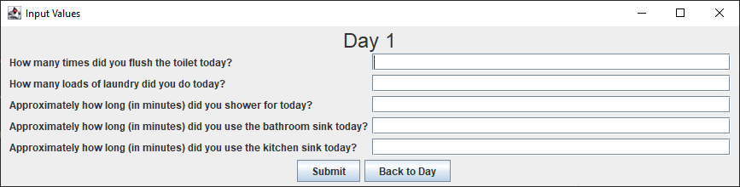
Design
Graphical application consisting of multiple windows
Allows user to input simple information about daily water consumption in order to gauge how much they waste or save on average
Saves daily water consumption over the period of a month in order to show consumption over a longer duration of time

Slide 5
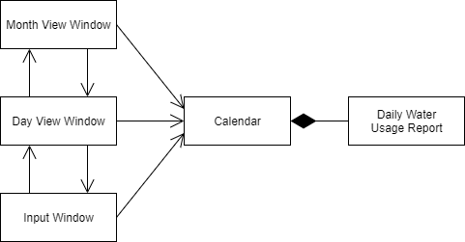
Implementation
Written in Java
GUI consists of three windows, with only one being displayed at a time
Month view window
Day view window
Input window
All the windows share a calendar which is used to store the daily consumption values

Slide 6
Sources
https://blogs.ei.columbia.edu/2019/09/23/climate-change-impacts-water/
https://www.home-water-works.org/indoor-use
https://www.whirlpool.com/blog/washers-and-dryers/he-washing-machine-water-usage.html

